Slide 1
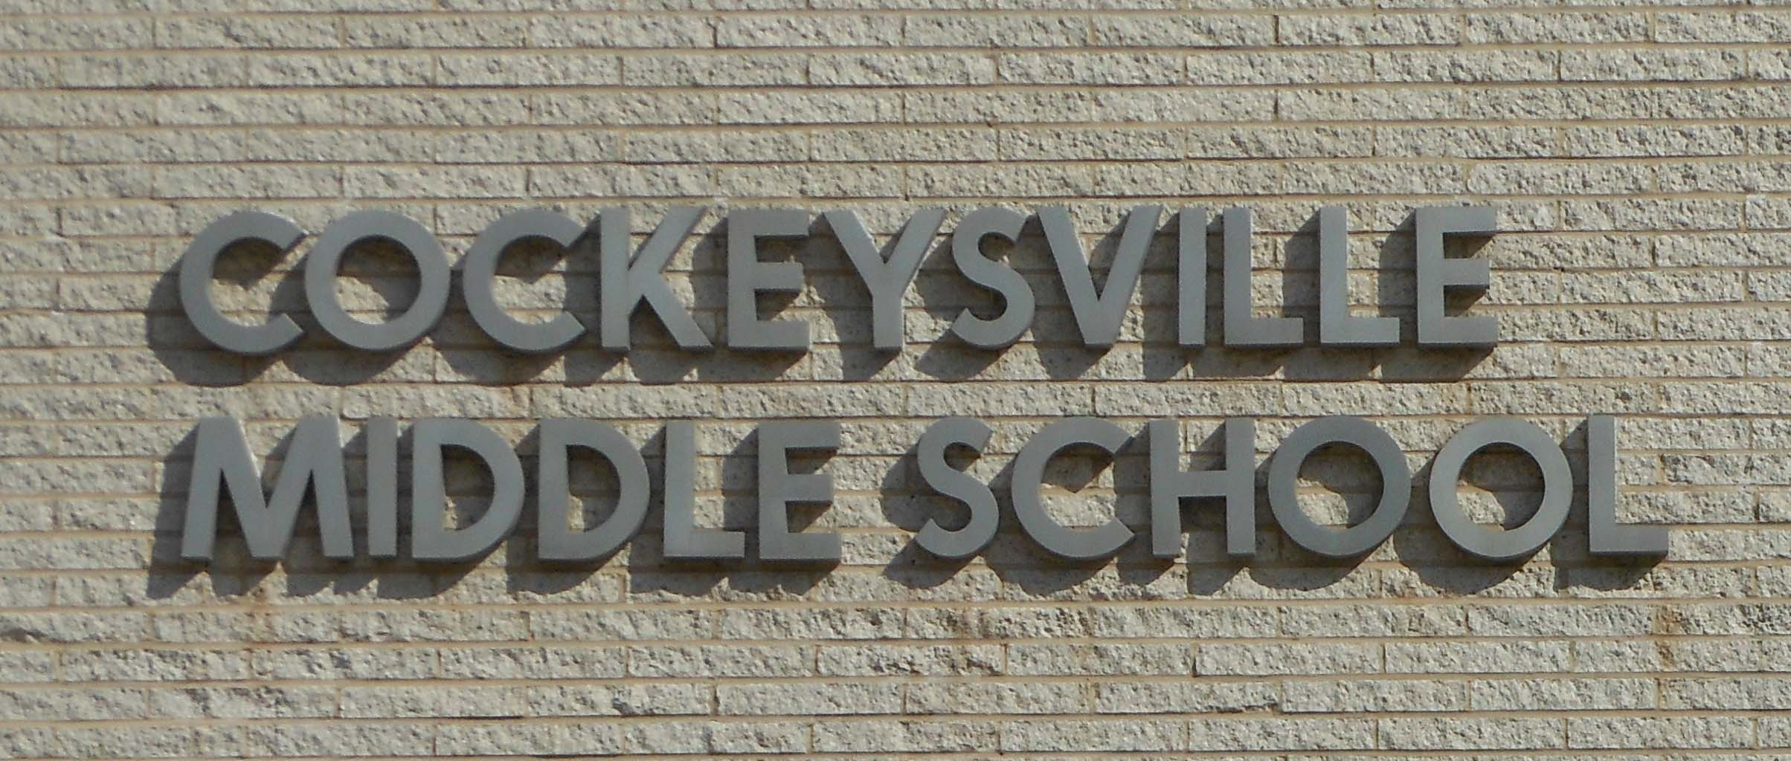

Cockeysville Middle School (please use the link in the chat to sign in on Google Forms)
Cockeysville Middle School
Green School Committee

Slide 2
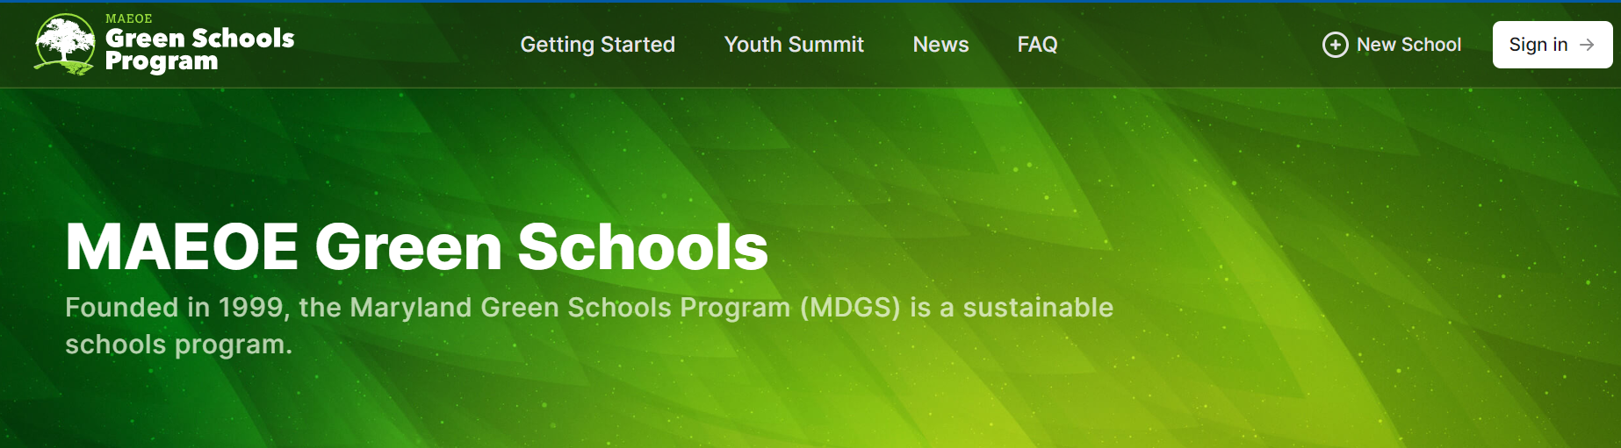
The Maryland Green Schools Program (MDGS) allows schools and their communities to evaluate their efforts in environmental sustainability. Schools empower youth to make changes to reduce environmental impact, encourage sustainability, and foster environmental literacy.

Slide 3
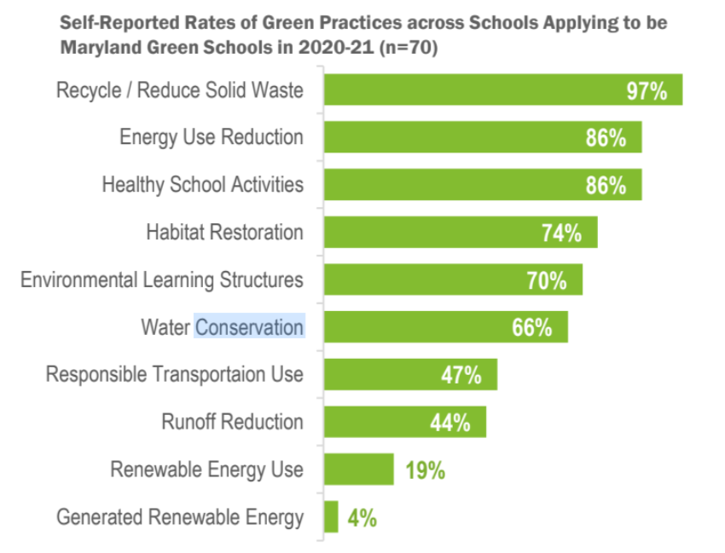
Green Practices Across Maryland Schools (public and private):
There are currently 664 Green Schools in Maryland.
As of 2021, 33% of Maryland schools are Green School certified.

Slide 4

OVERVIEW
CMS has been considered a Green School since 2008
We are up for recertification this year (our 4th recertification).
Deadline for submission = March 1st
Ideas for submission:
Any Environmental Education Professional Development that you attend
Any curriculum or instruction that ties into Environmental Issues or
Environmental Literacy
Any partnerships with community members relating to Environmental Issues
Any school-wide Environmental Behavior Changes (non-student and student driven)

Slide 5

DOCUMENT! DOCUMENT! DOCUMENT!
Info and pictures!
Resources in the Schoology CMS Professional Learning folder
Submit in the Google Shared folder: “Green School Recertification 2022-2023” with your name on it (in progress).
Please complete the following information when submitting activities that you have completed for the CMS Green School recertification for our March 18th deadline. (Make sure you submit by March 1st to be included).
Sincerely,
The Green School Committee
Teacher: ______________
Date: _________________
Description of Classroom/Outdoor Activity:
__________________________________________________________________________________
__________________________________________________________________________________
__________________________________________________________________________________

Slide 6

Ideas for Environmental Content:
Share lessons about Environmental Education at team meetings and PD Days
Social Studies:
Teach about natural resources in
Language Arts:
Write poetry/read books related to the environment
Math:
Solving word problems related to the environment
Gym:
Any kind of outside activity
Art:
Drawing landscapes or using recycled objects
Foreign Language:
Having an environmental conversation

Slide 7
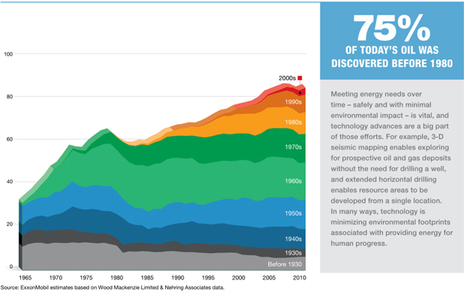
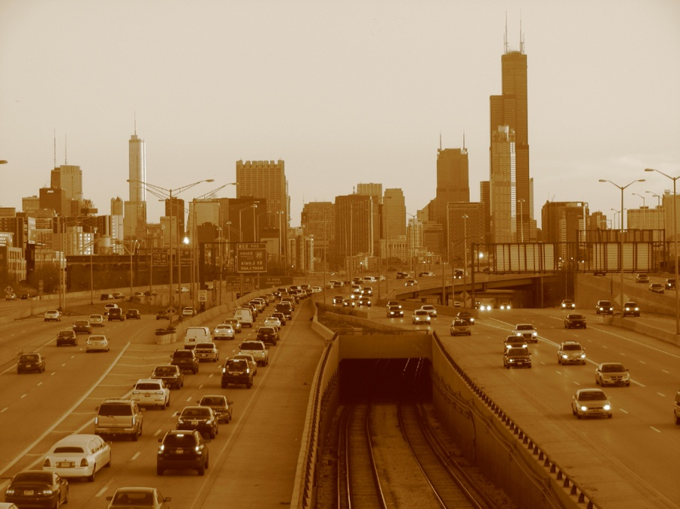
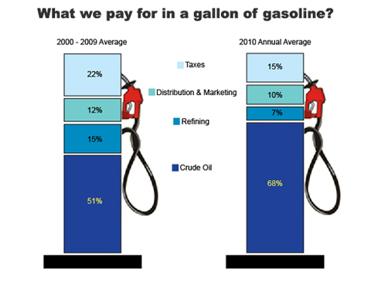
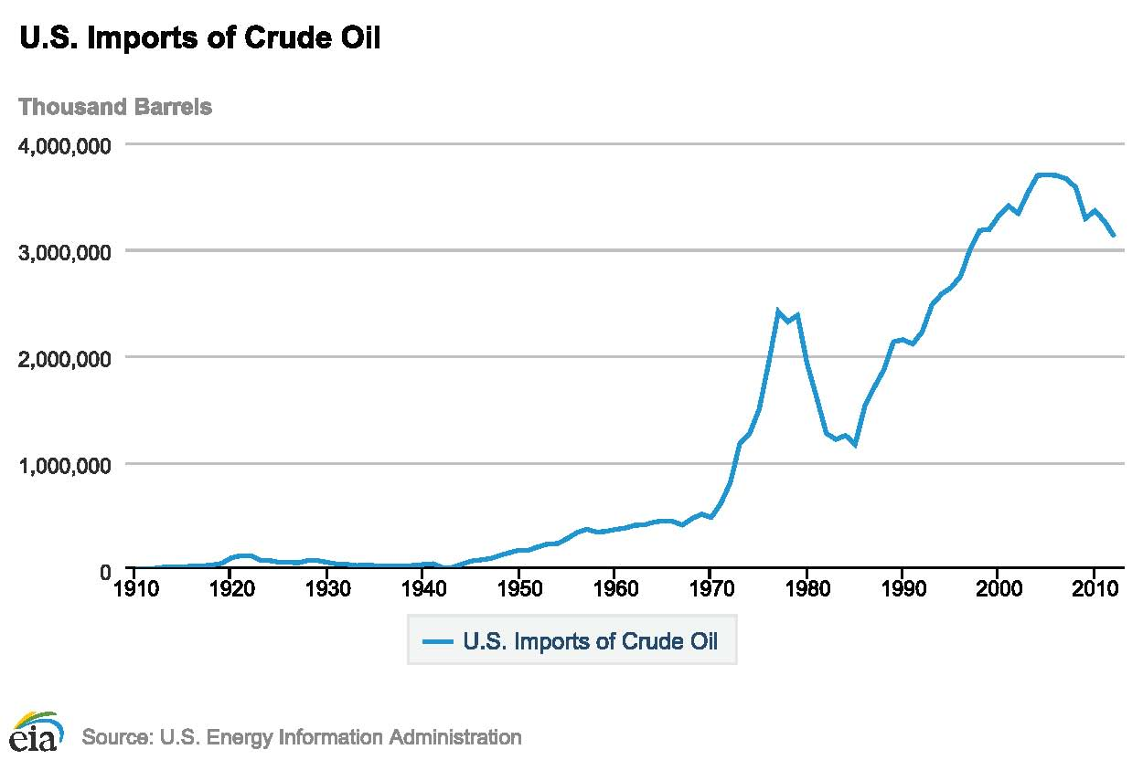
World Cultures:
Production and Consumption of Oil

Slide 8
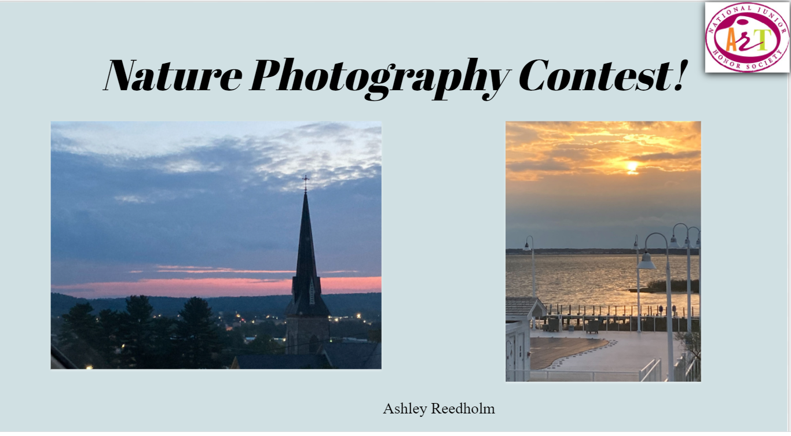

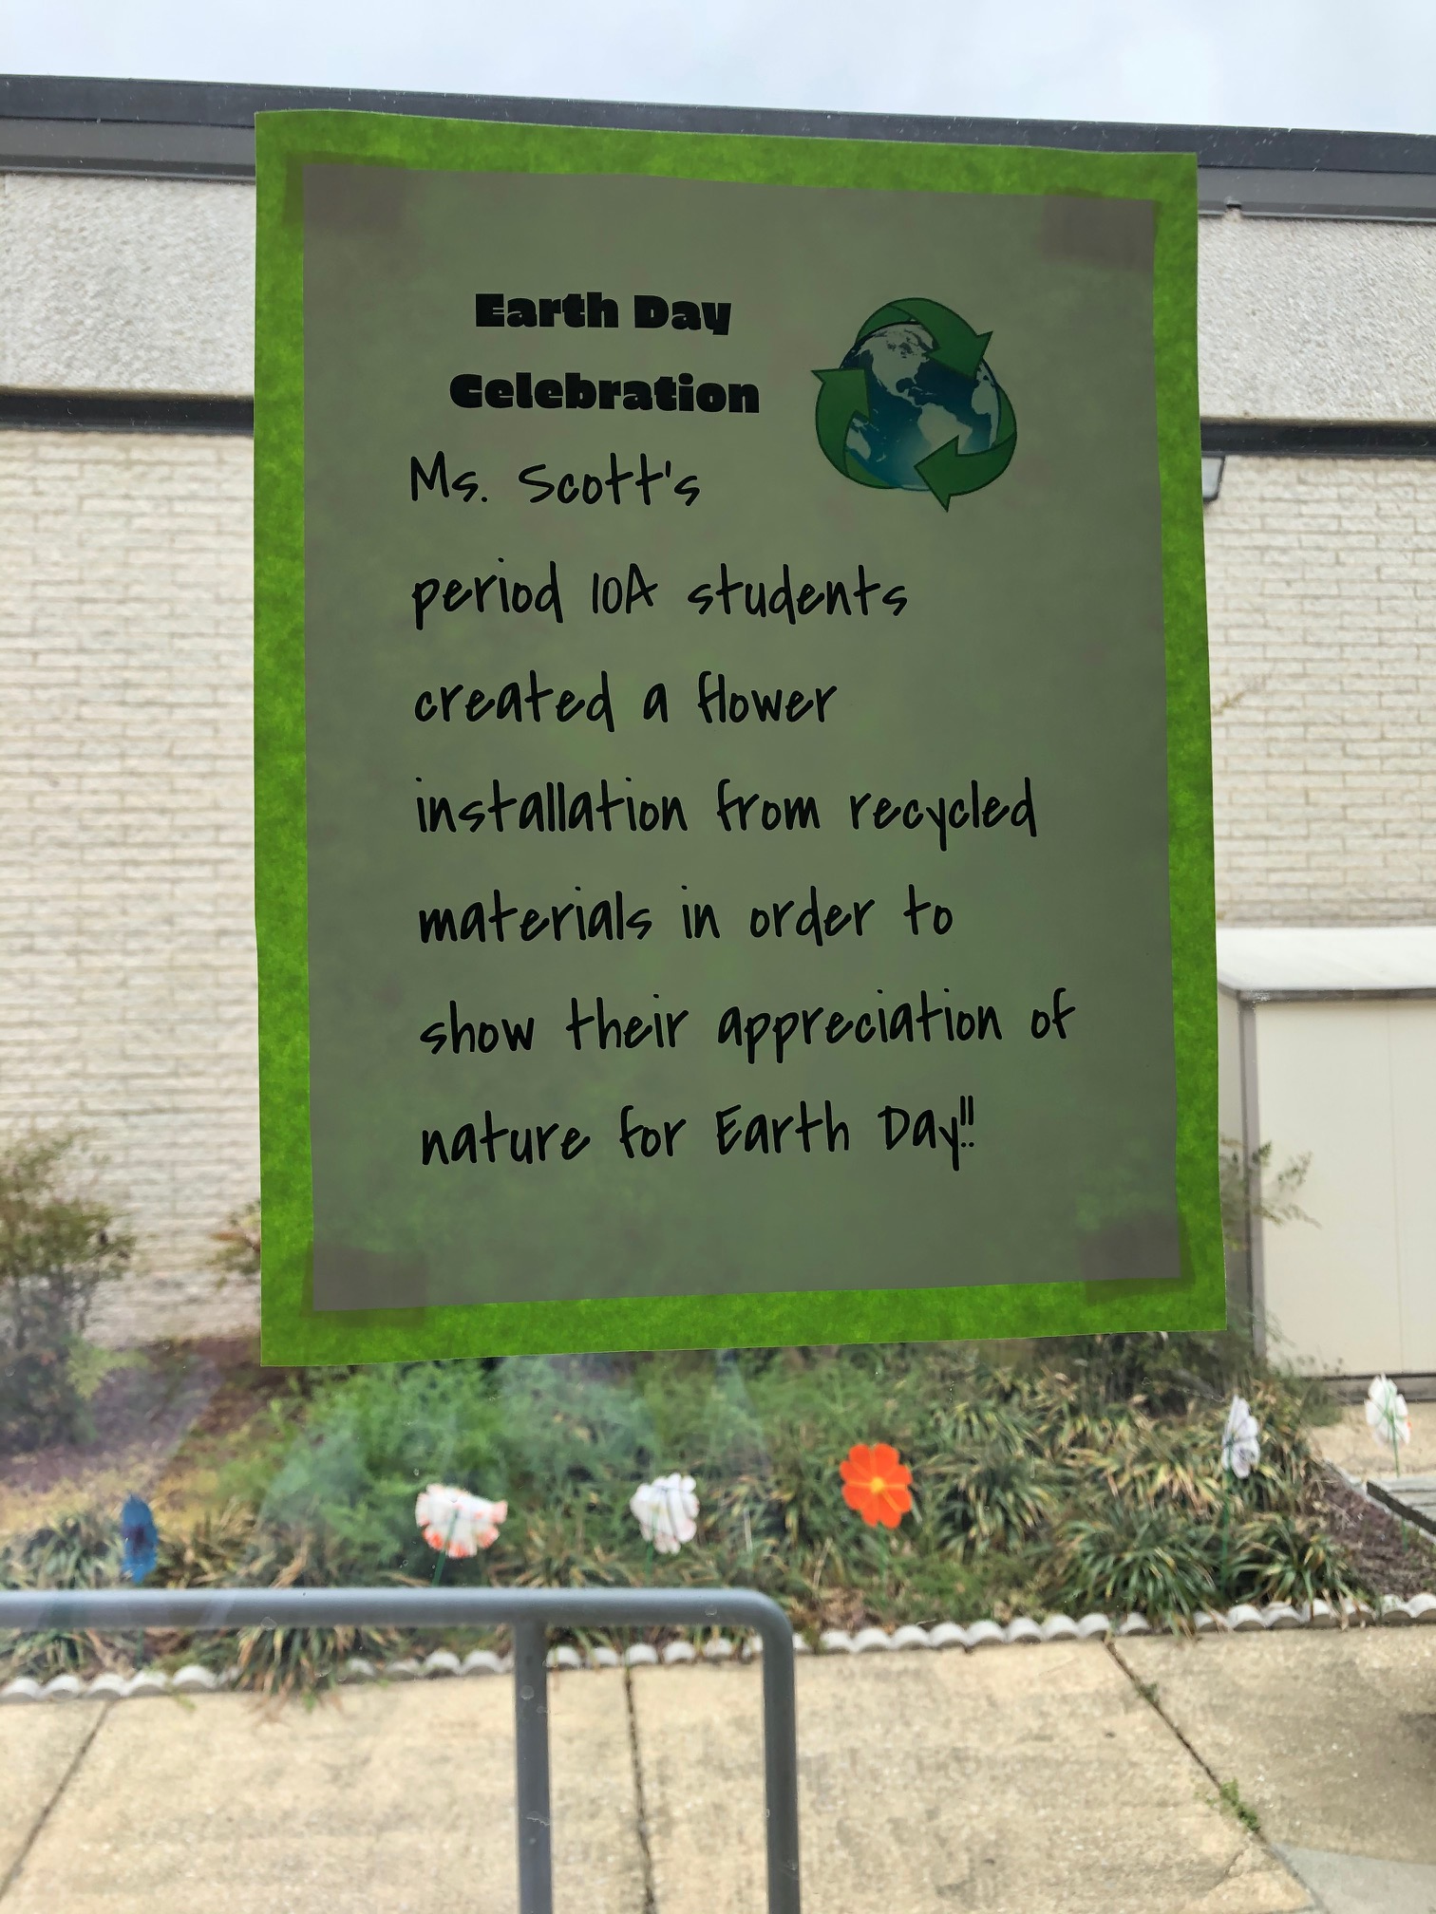
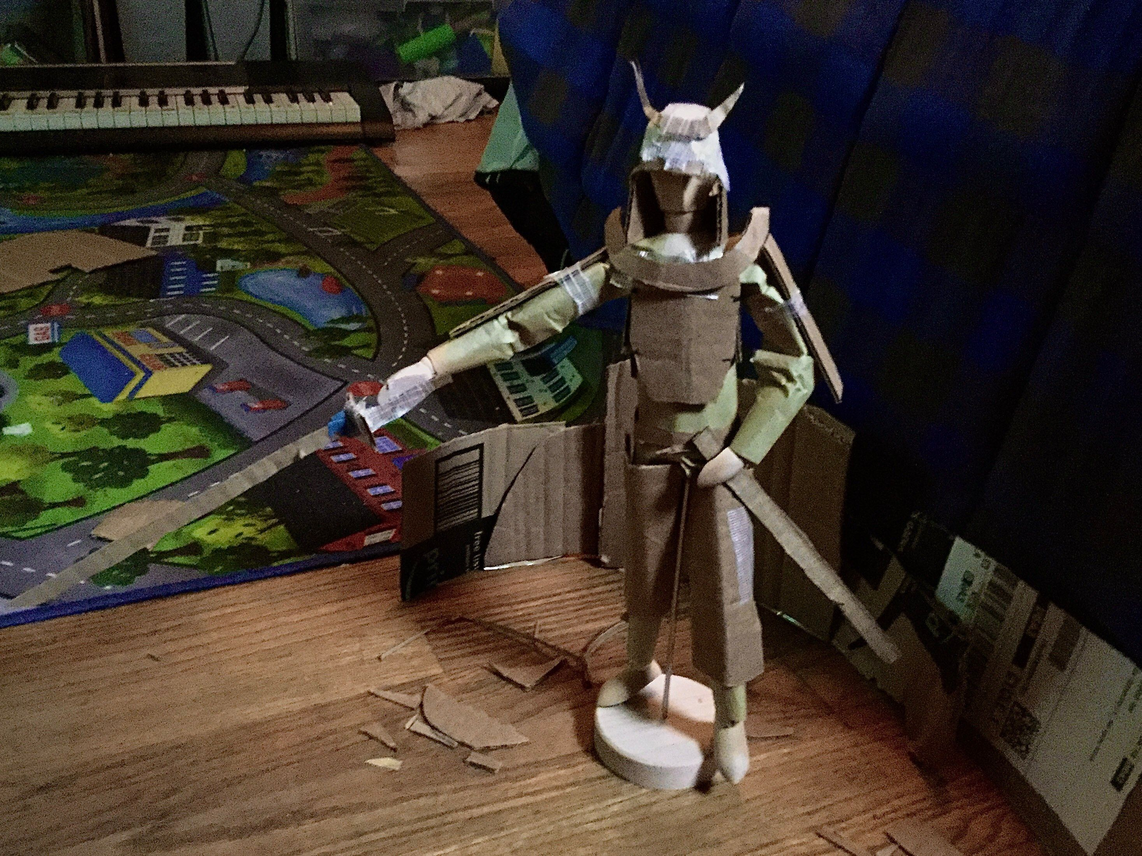
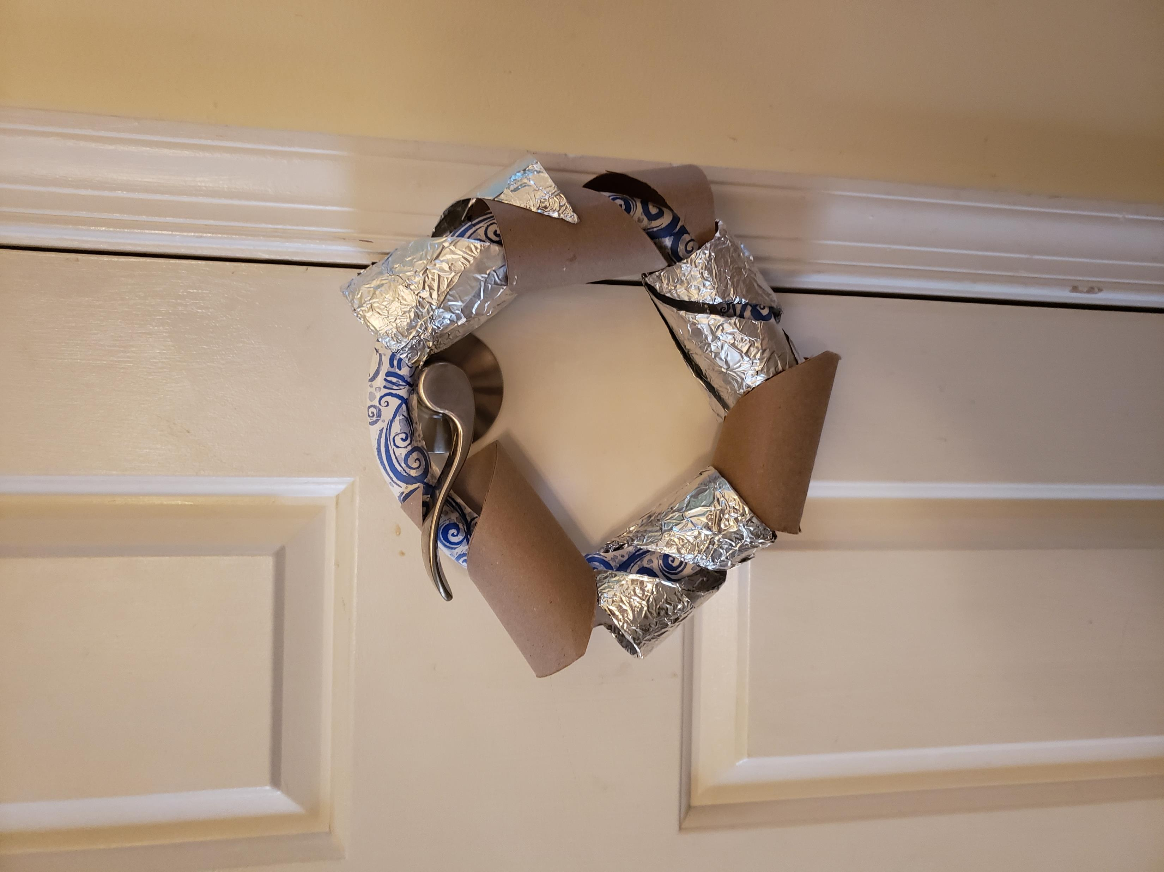
Art:

Slide 9
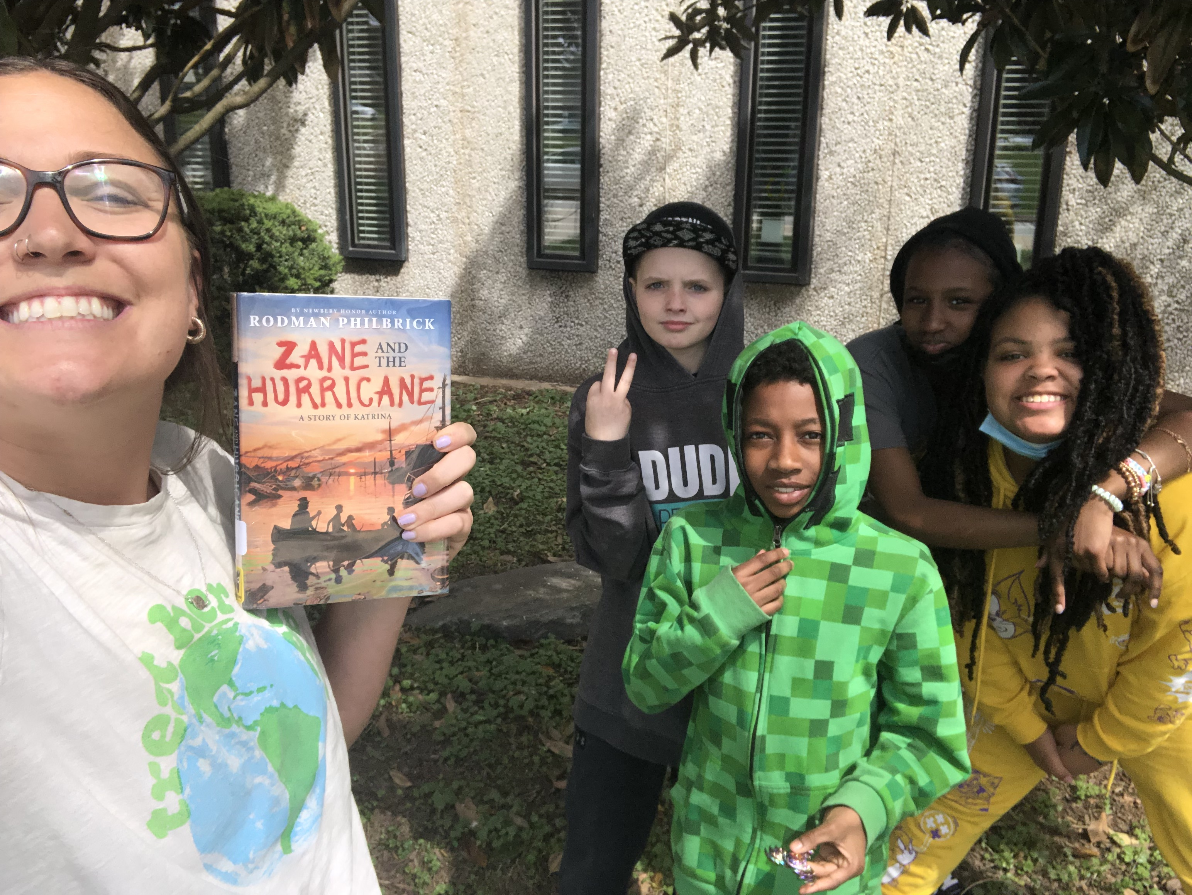
Language Arts:

Slide 10
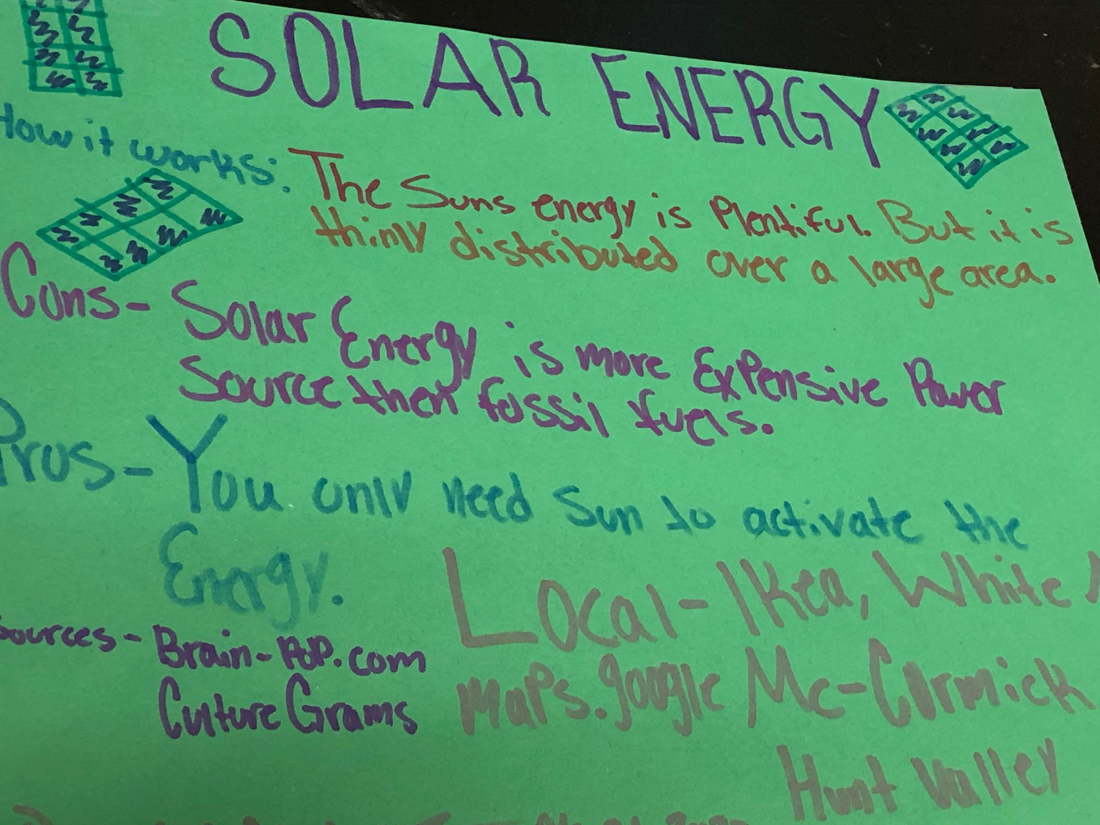
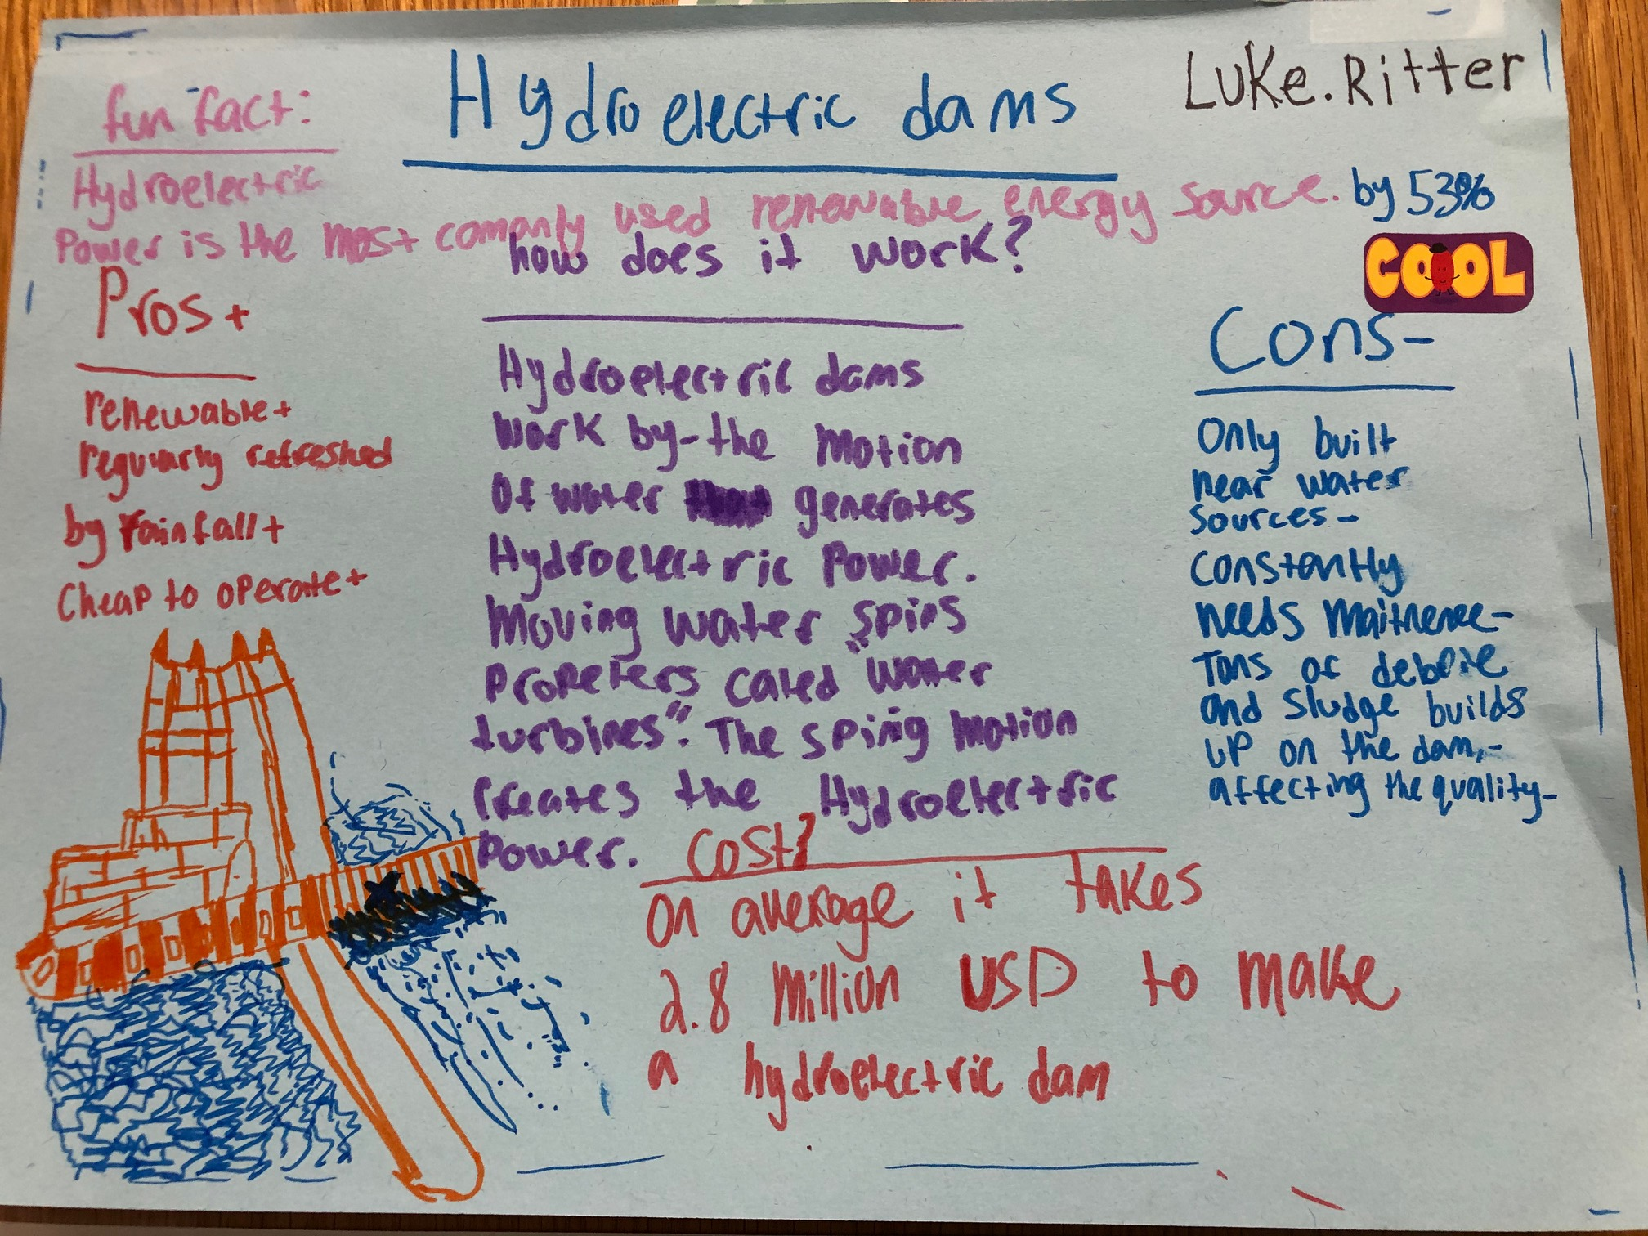
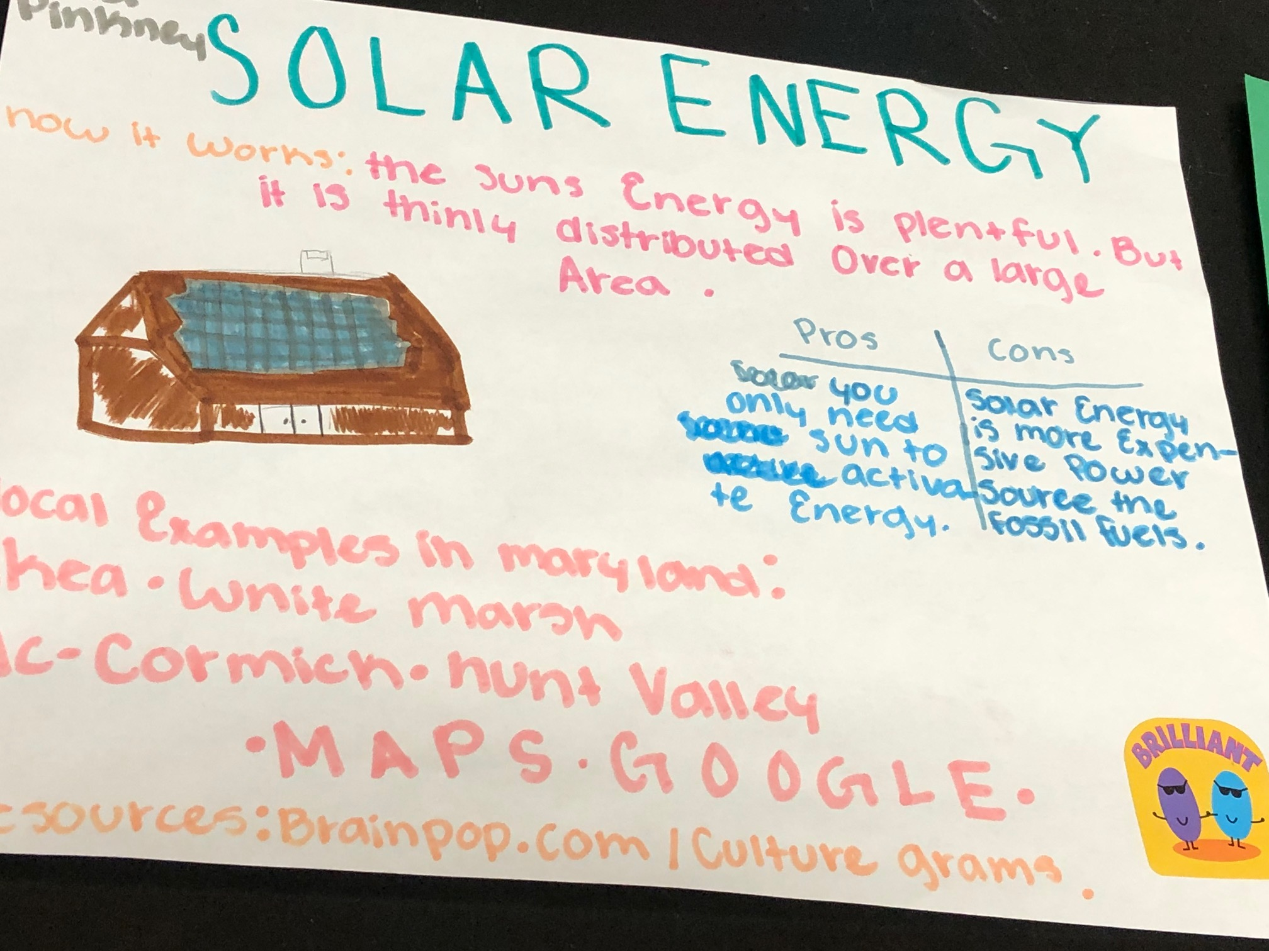
Science:

